Slide 1
QUIC (Quick UDP Internet Connection)
UDP-based Multiplexed and Secure Transport

Slide 2
Topics
HTTP/2 (SPDY) over TCP
QUIC = TCP + TLS/1.3 + HTTP/2
HTTP/3 (over QUIC/UDP)
QUIC WG in IETF

Slide 3
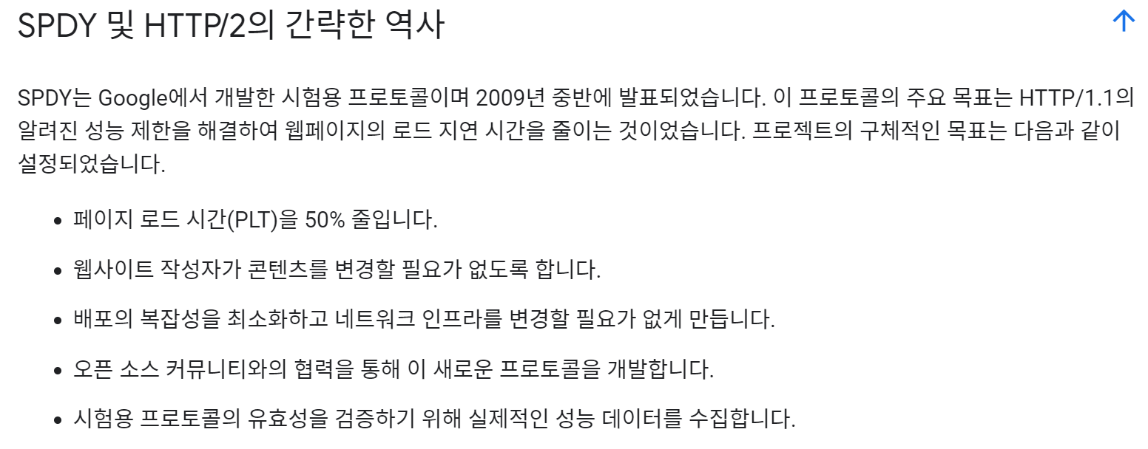
SPDY vs. HTTP/2

Slide 4
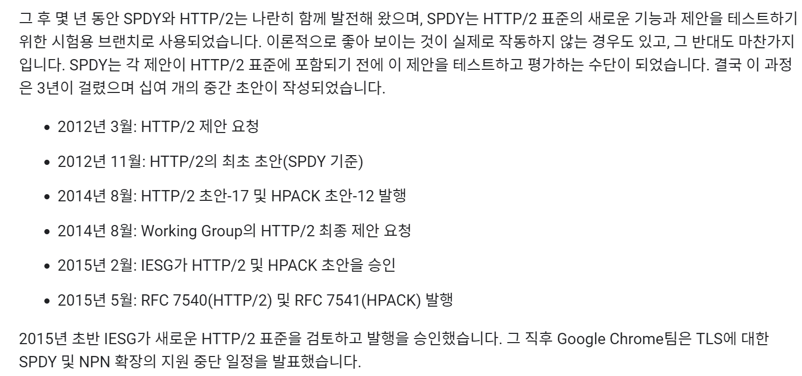
SPDY vs. HTTP/2

Slide 5
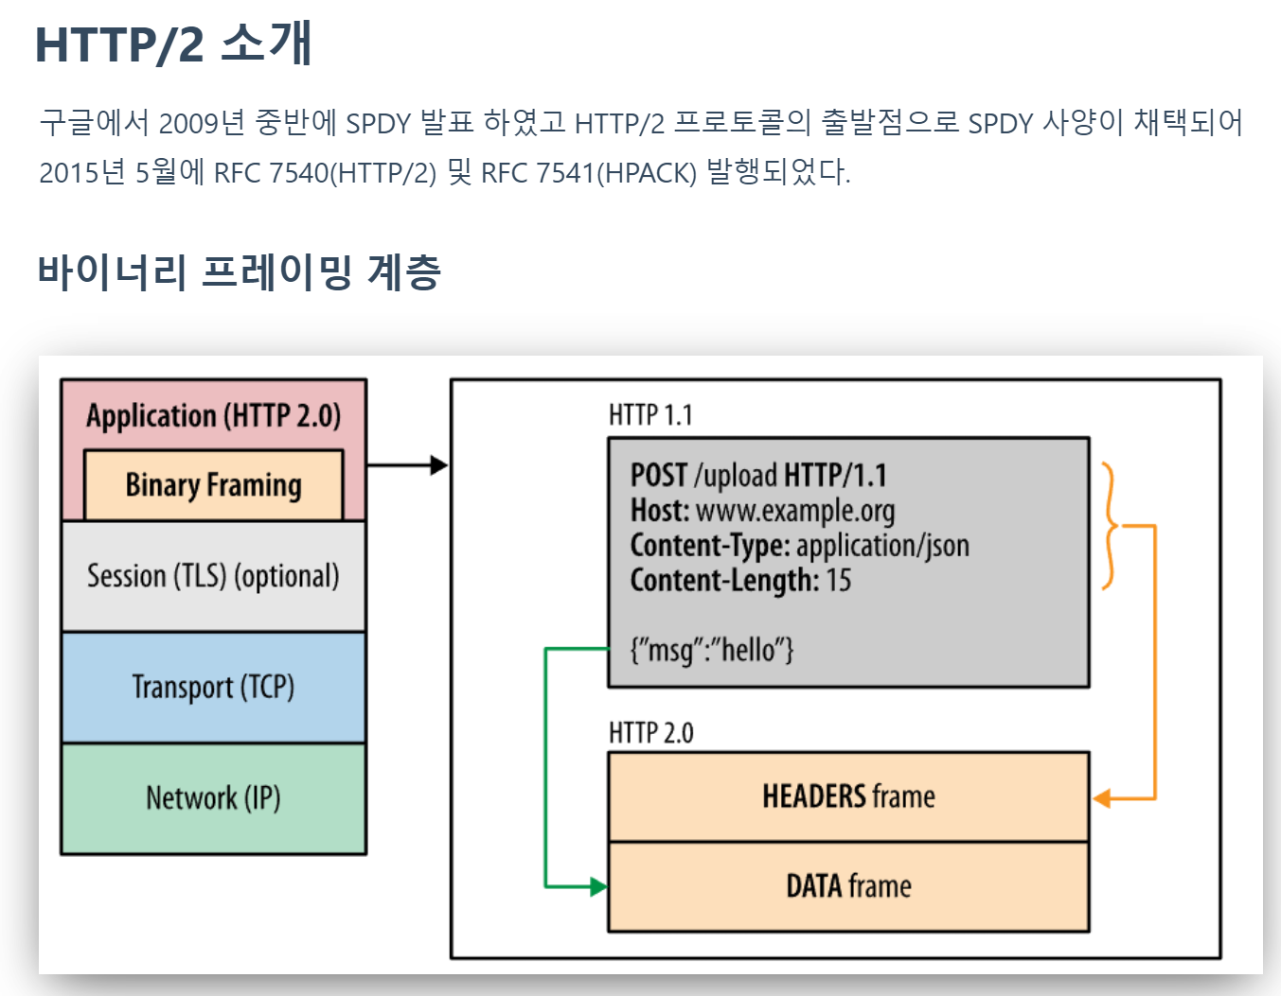

Slide 6
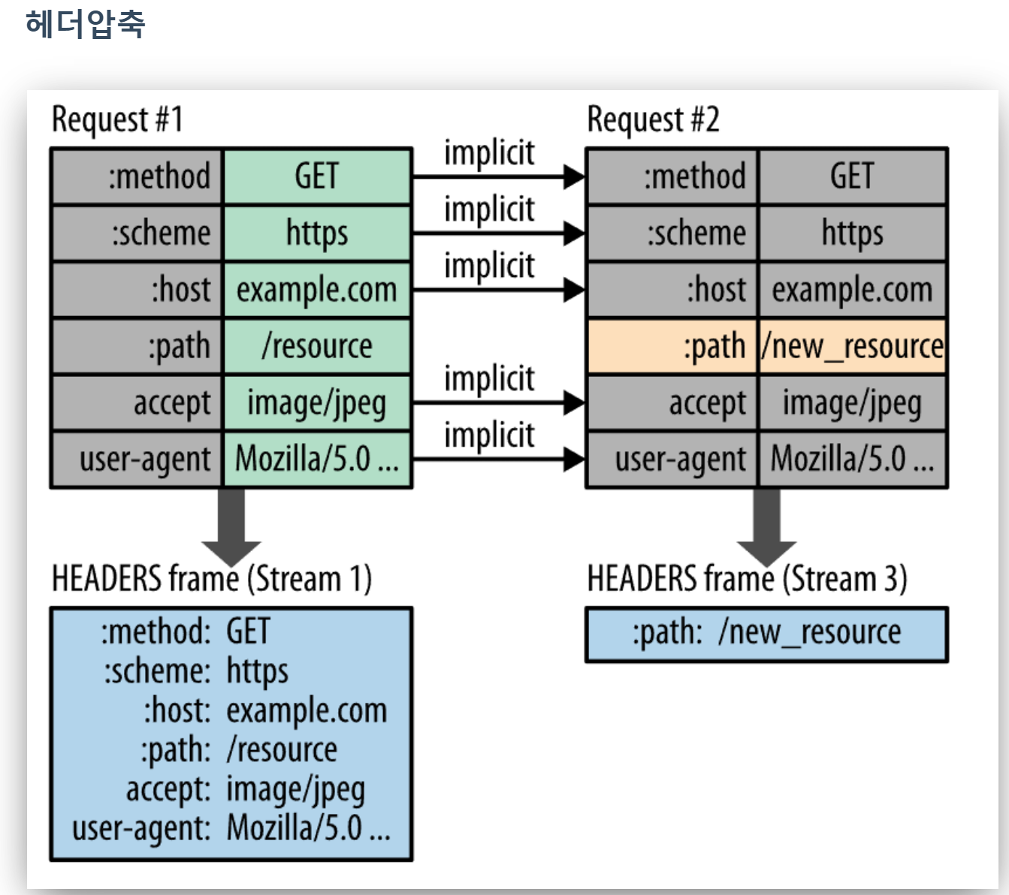
Header Compression in HTTP/2 (HPACK)

Slide 7
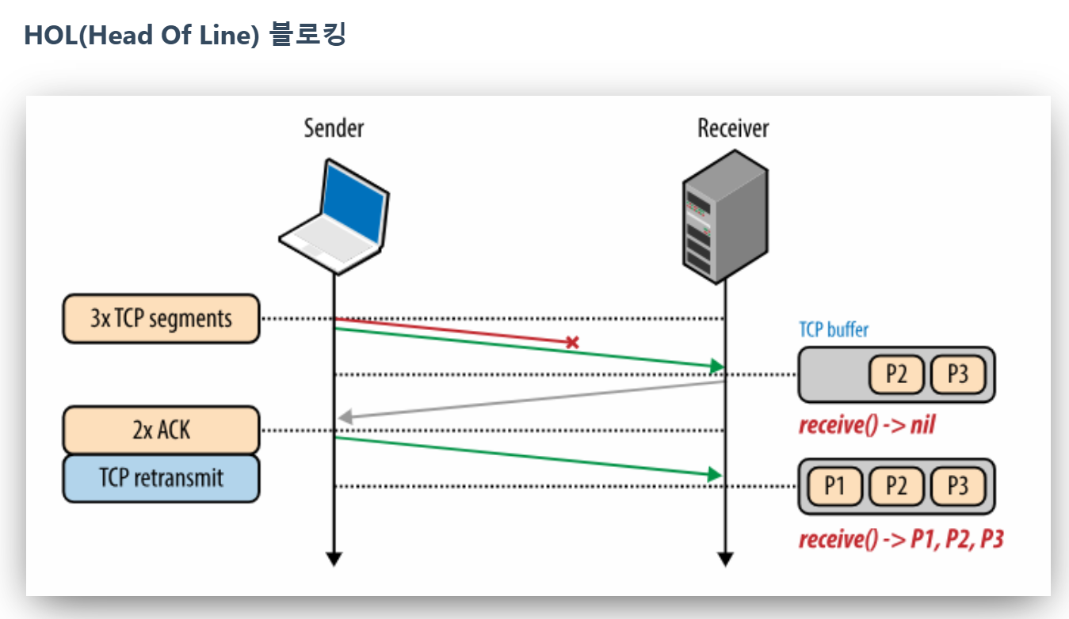
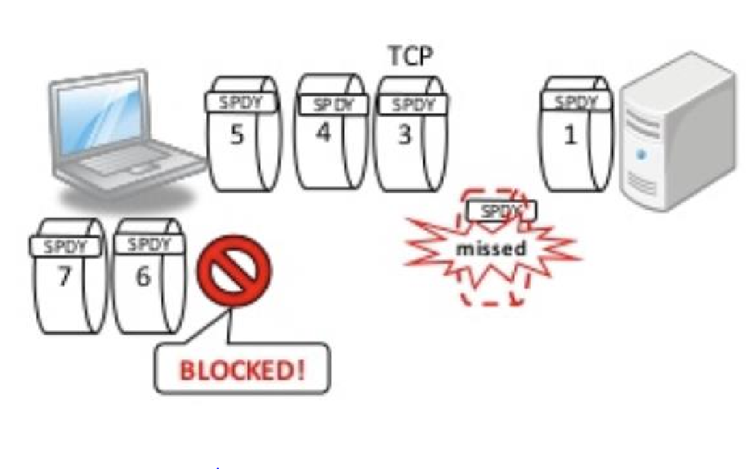
HoLB (Head-of-Line Blocking) in TCP

Slide 8
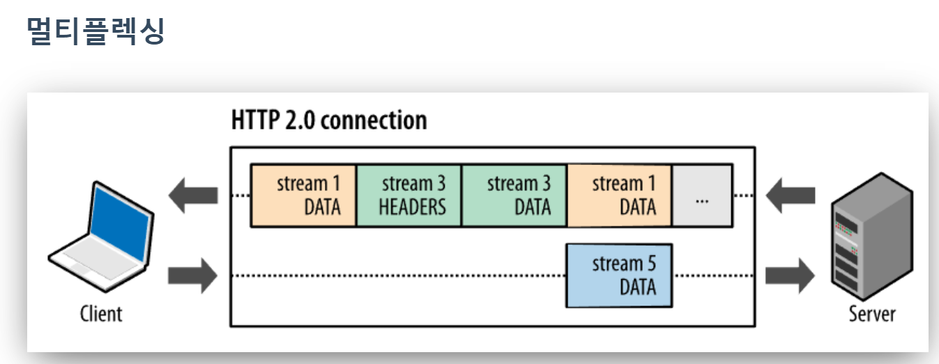
Stream Multiplexing in HTTP/2 (pipelining)

Slide 9
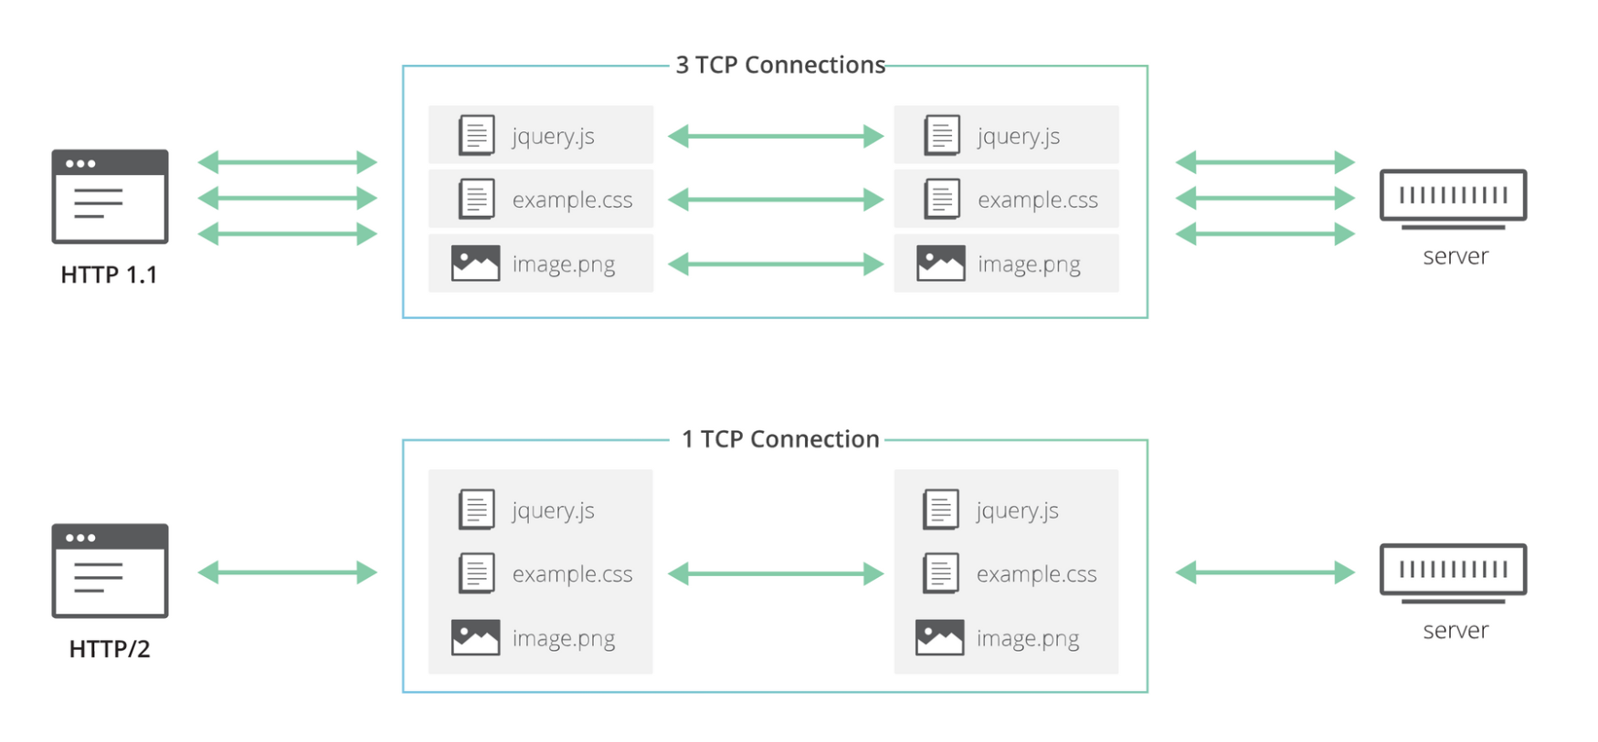
Stream Multiplexing in HTTP/2

Slide 10
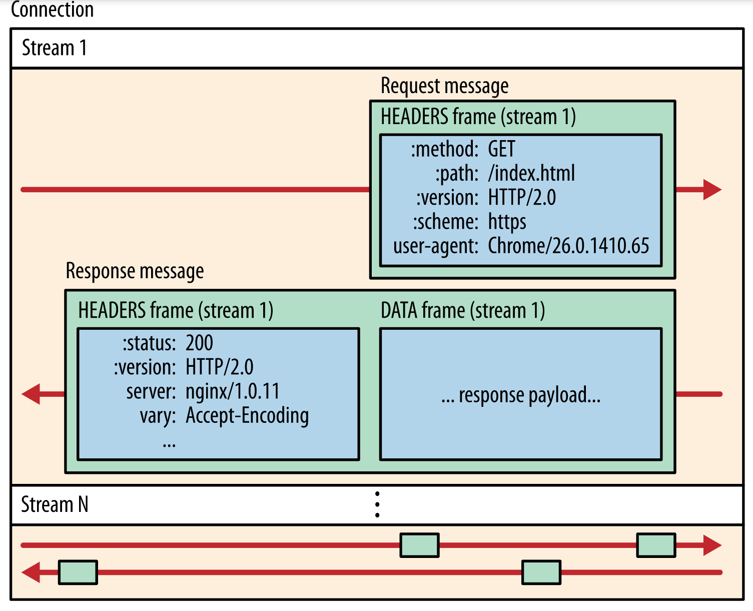
Multiple Streams in a Connection

Slide 11
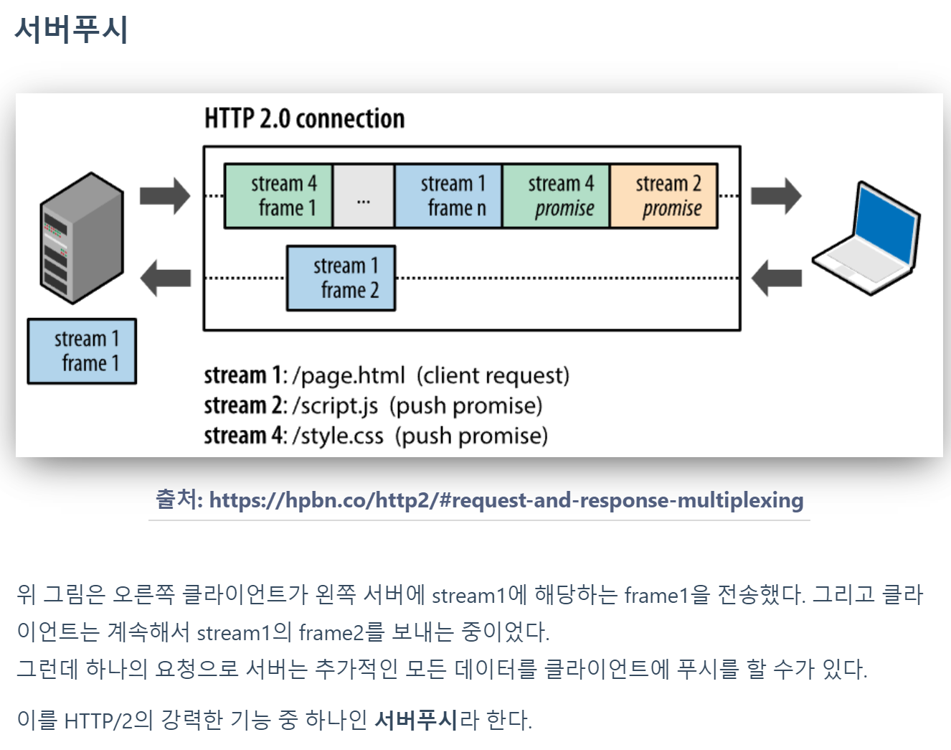
Server Push (PUSH_PROMISE)

Slide 12
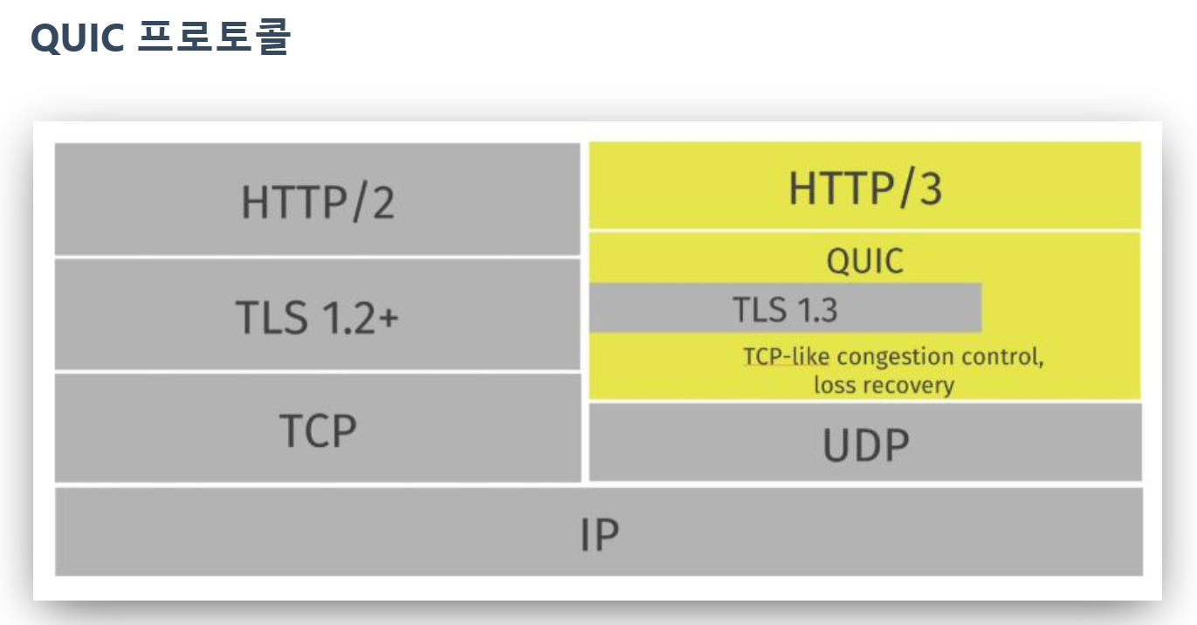
QUIC

Slide 13
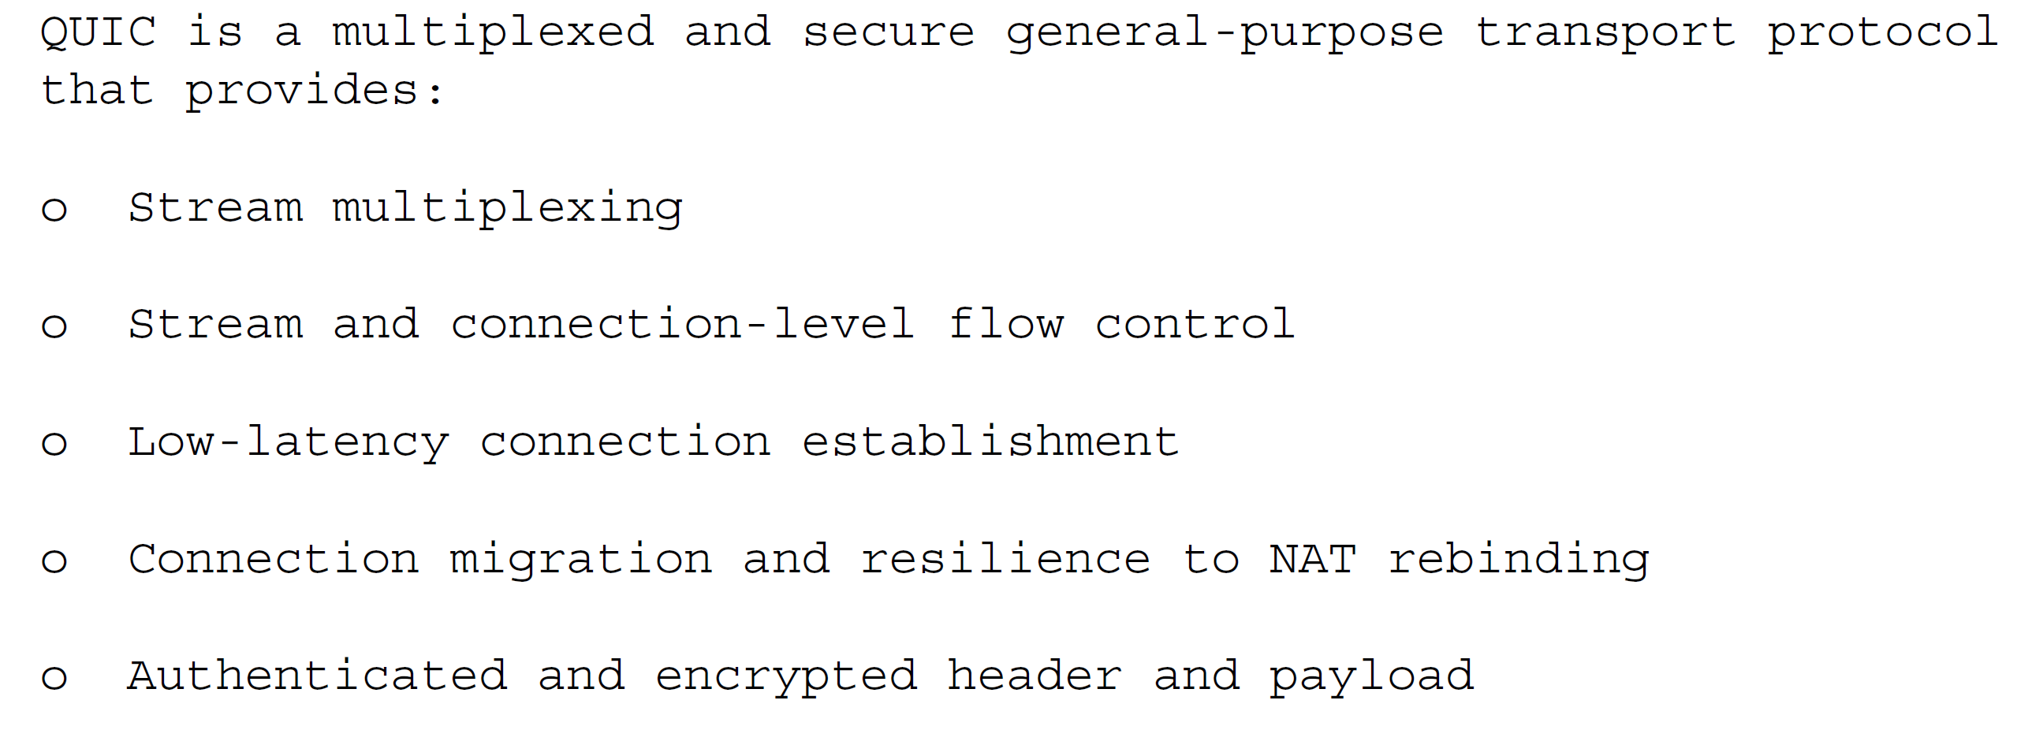
QUIC

Slide 14
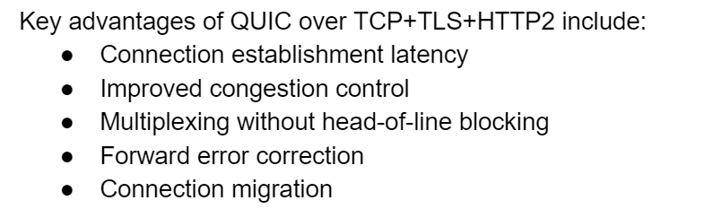
QUIC

Slide 15
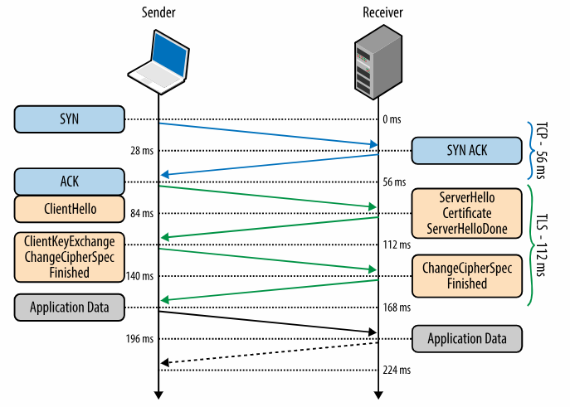
TCP & TLS

Slide 16
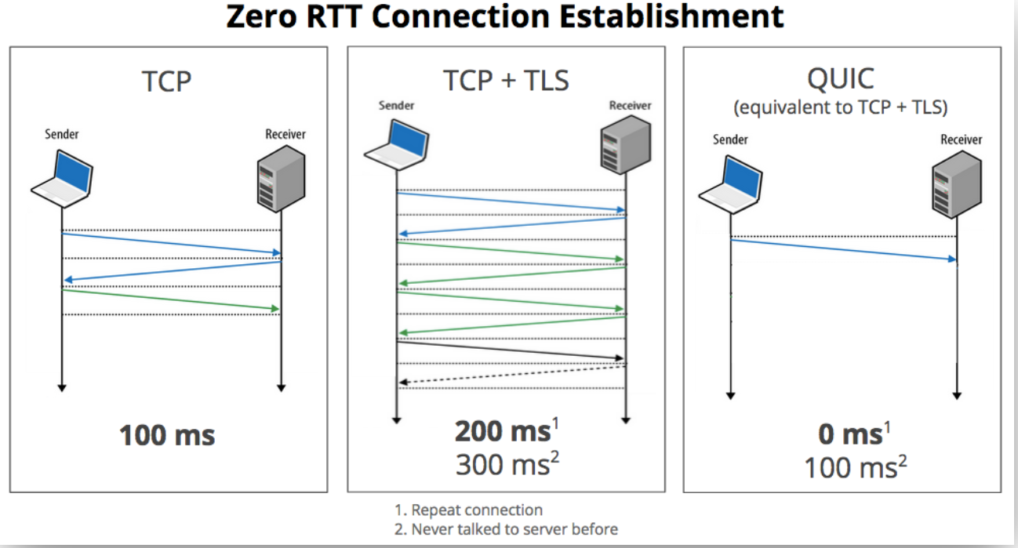
0-RTT & 1-RTT (data transport)

Slide 17
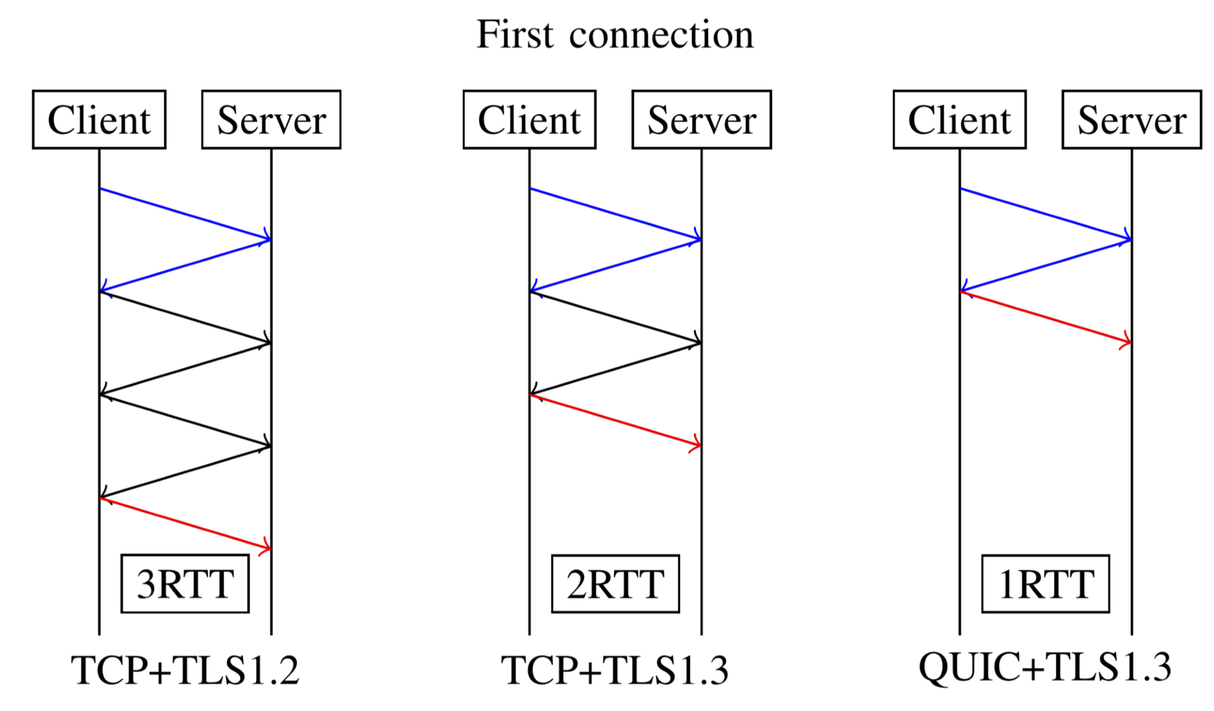
Connection Establishment

Slide 18
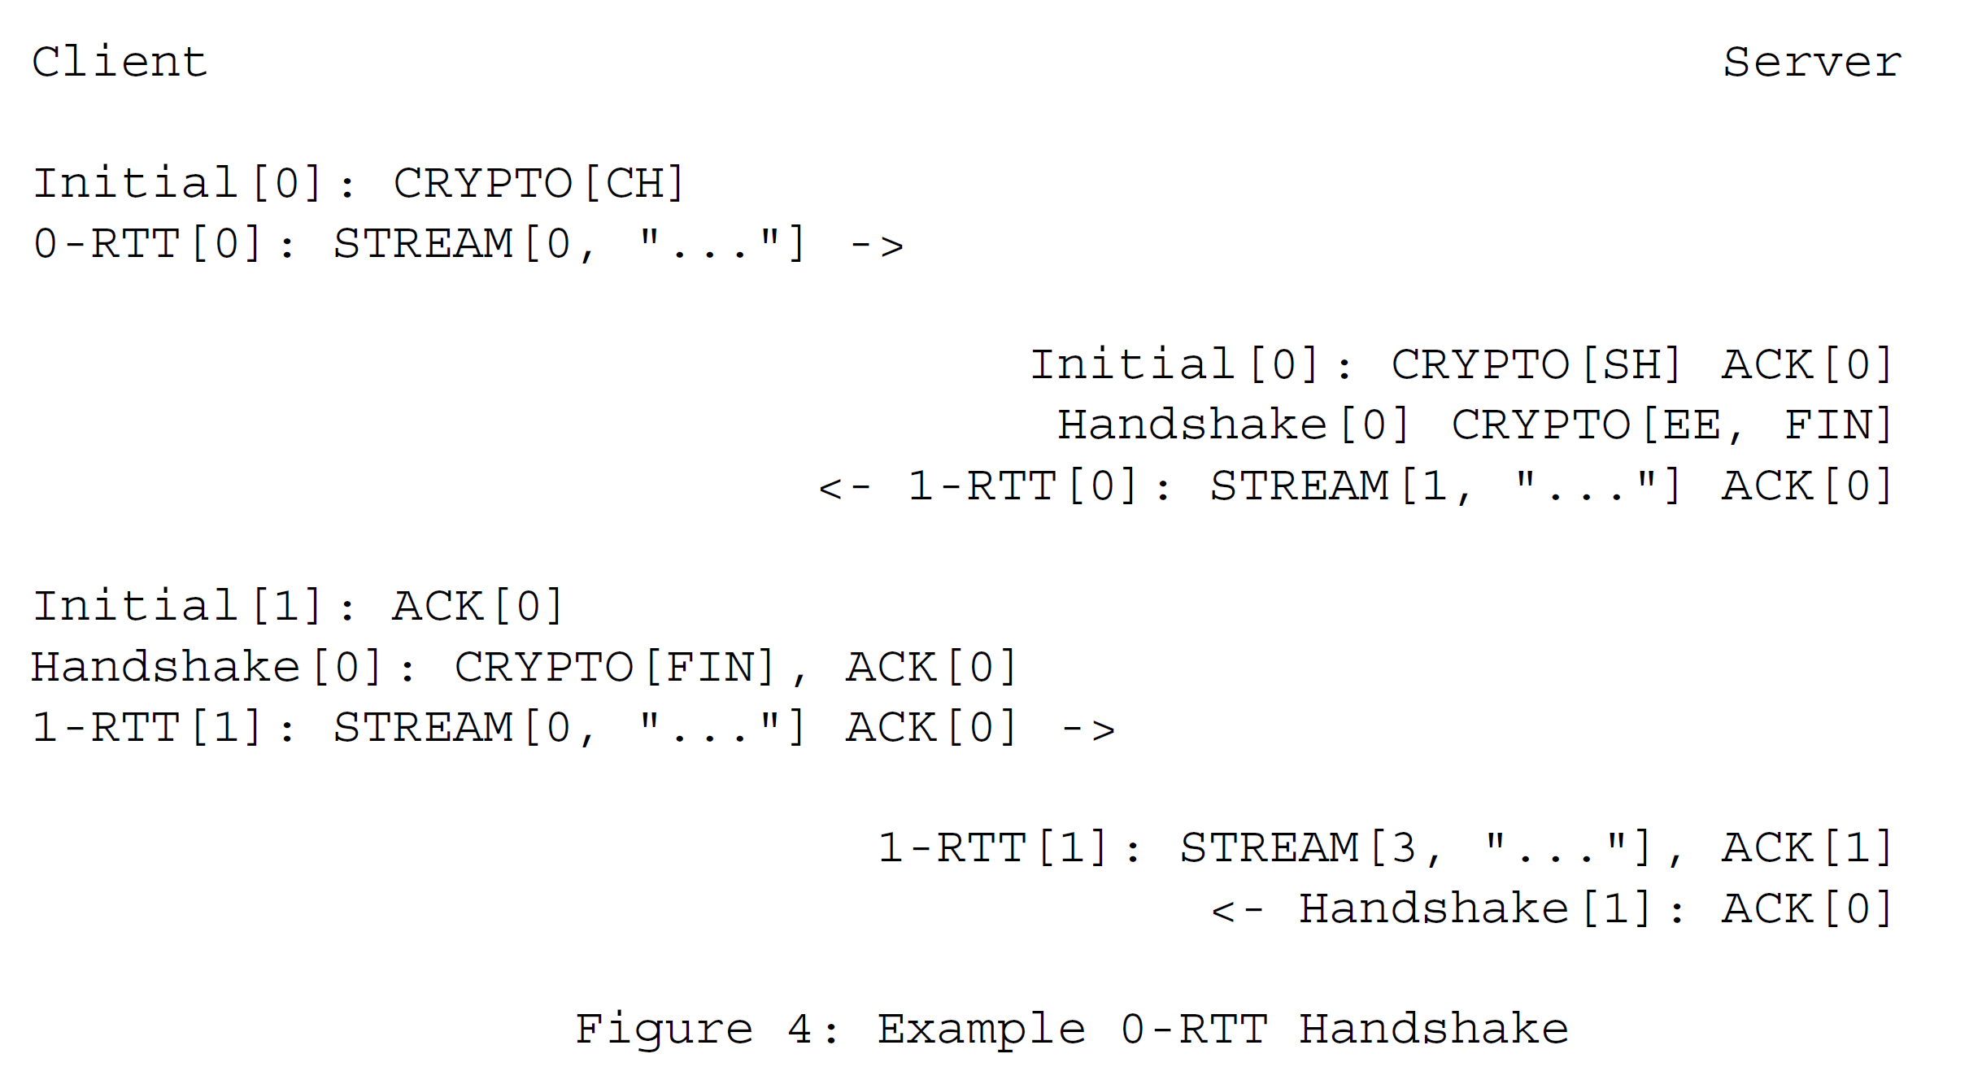
0-RTT Handshake

Slide 19
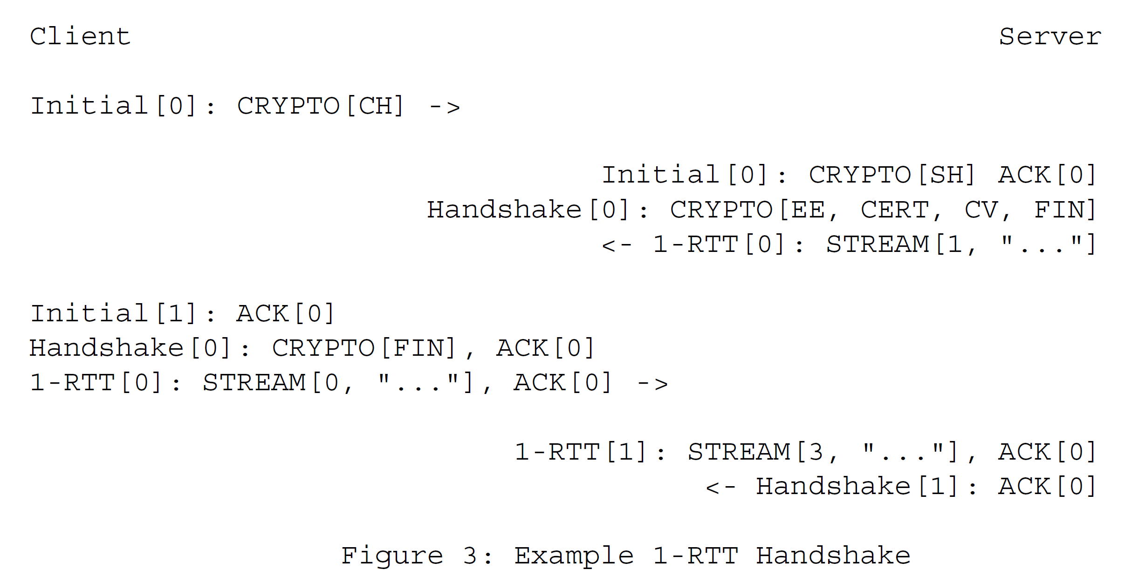
1-RTT Handshake

Slide 20
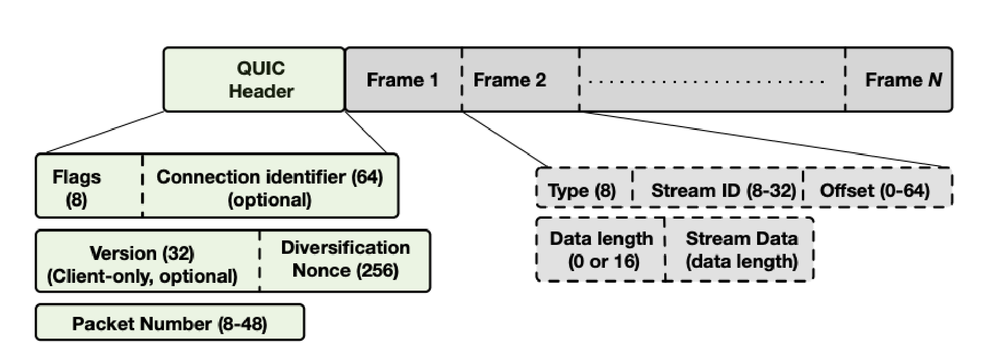
QUIC Packets (before modification)

Slide 21
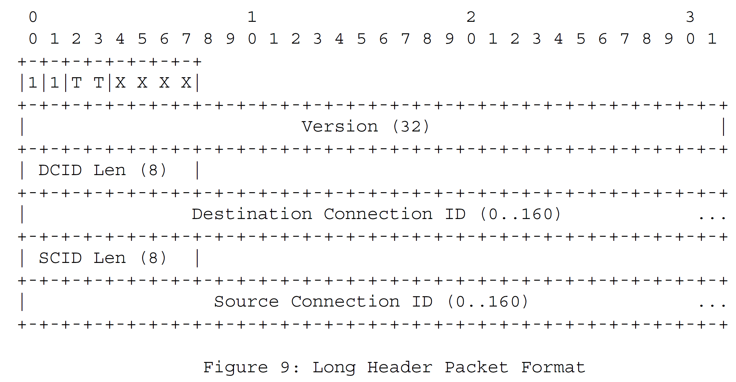
Long Header Packets

Slide 22
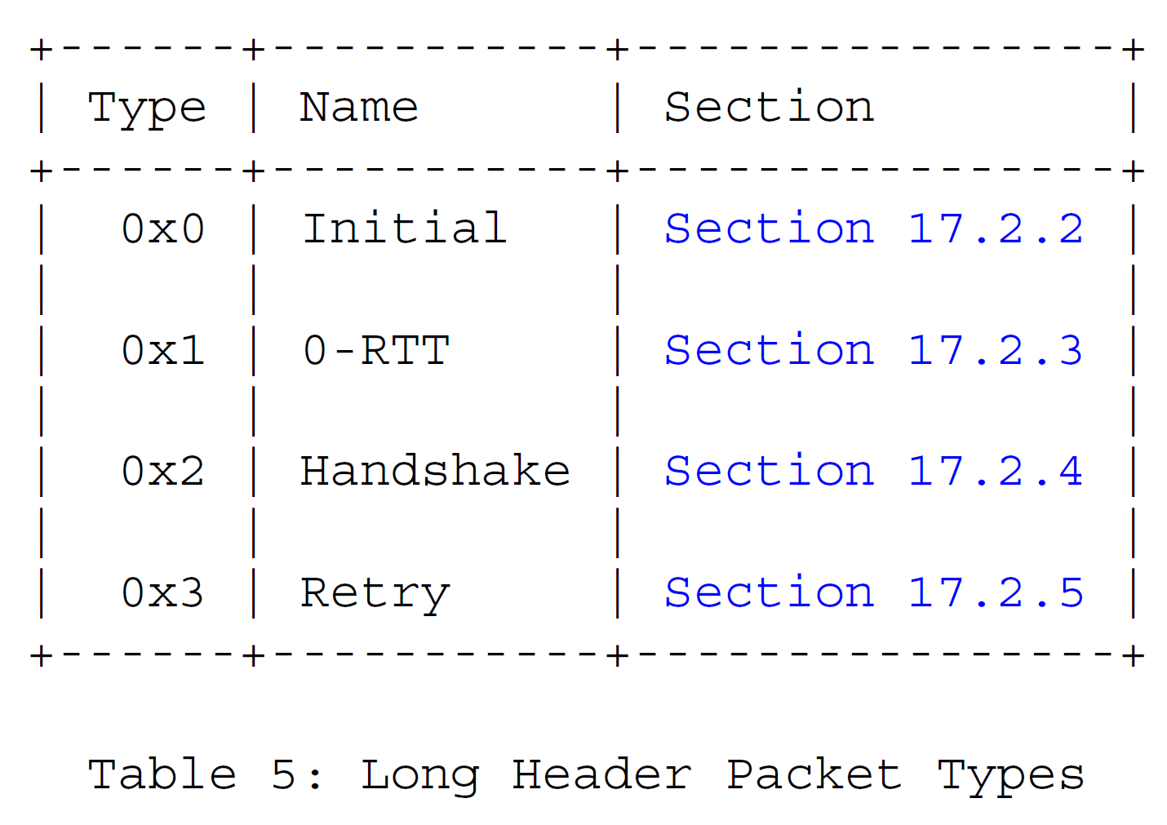
Long Header Packets

Slide 23
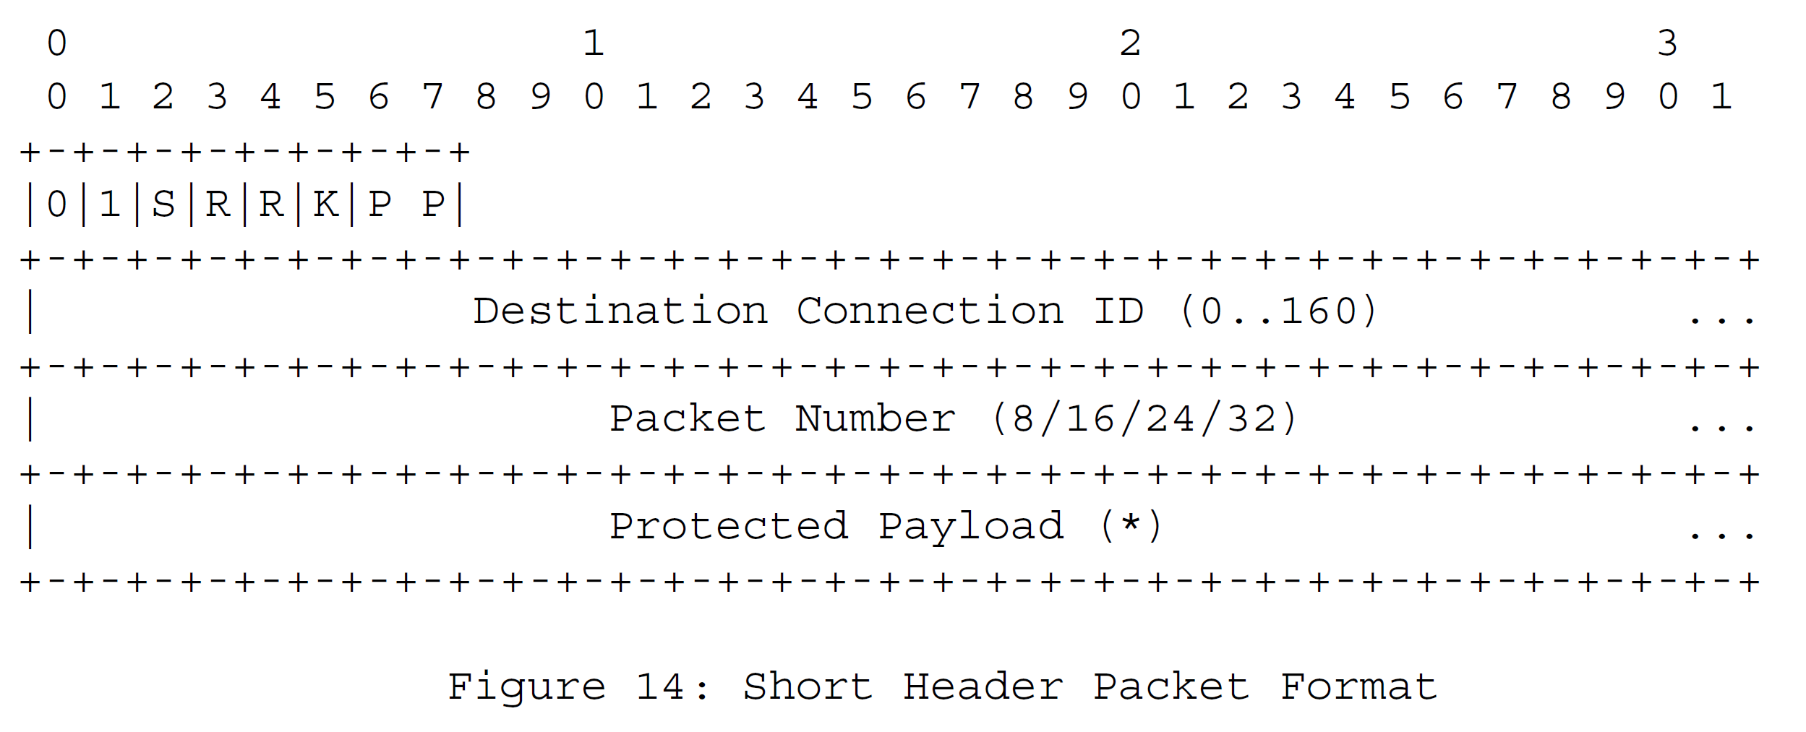
Short Header Packets

Slide 24
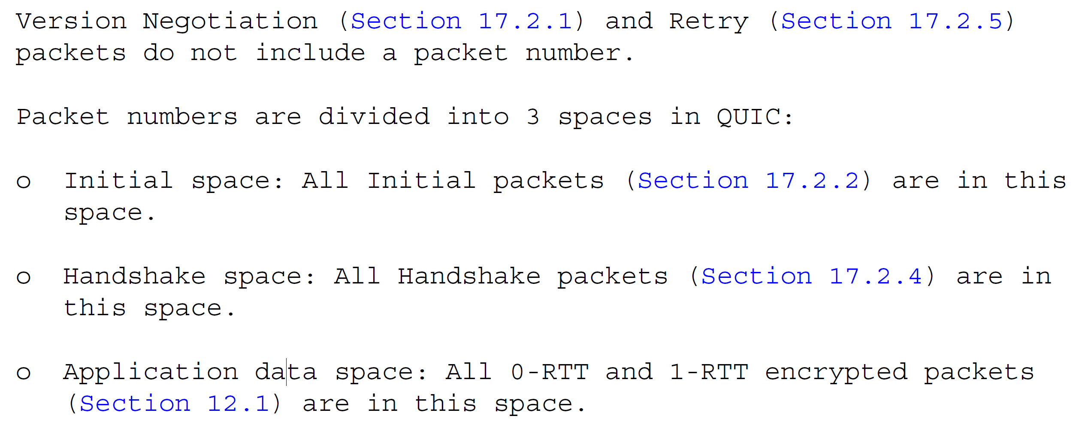
Packet Numbers (1~4 bytes)

Slide 25
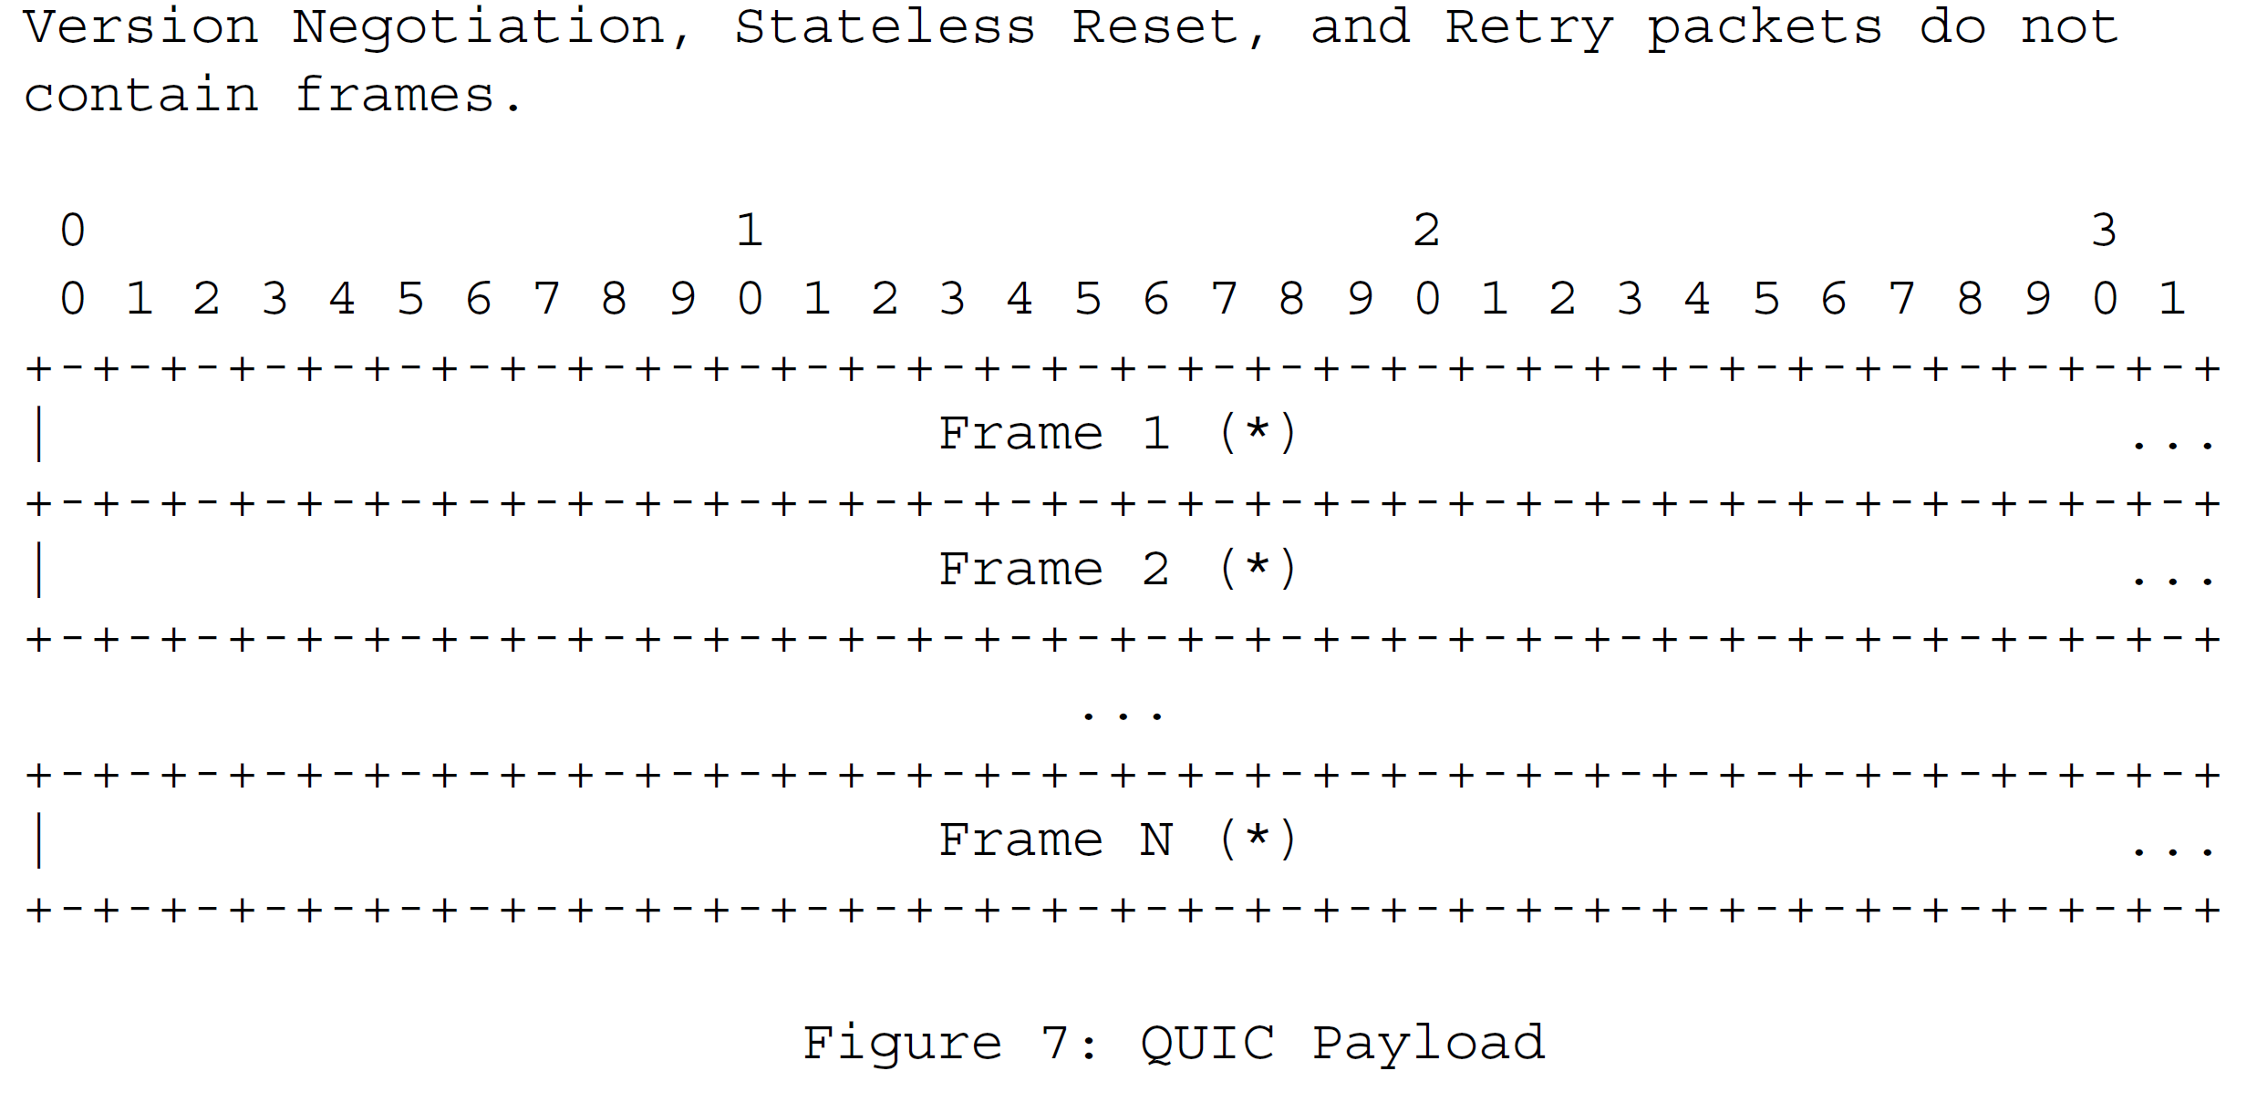
QUIC Frames

Slide 26
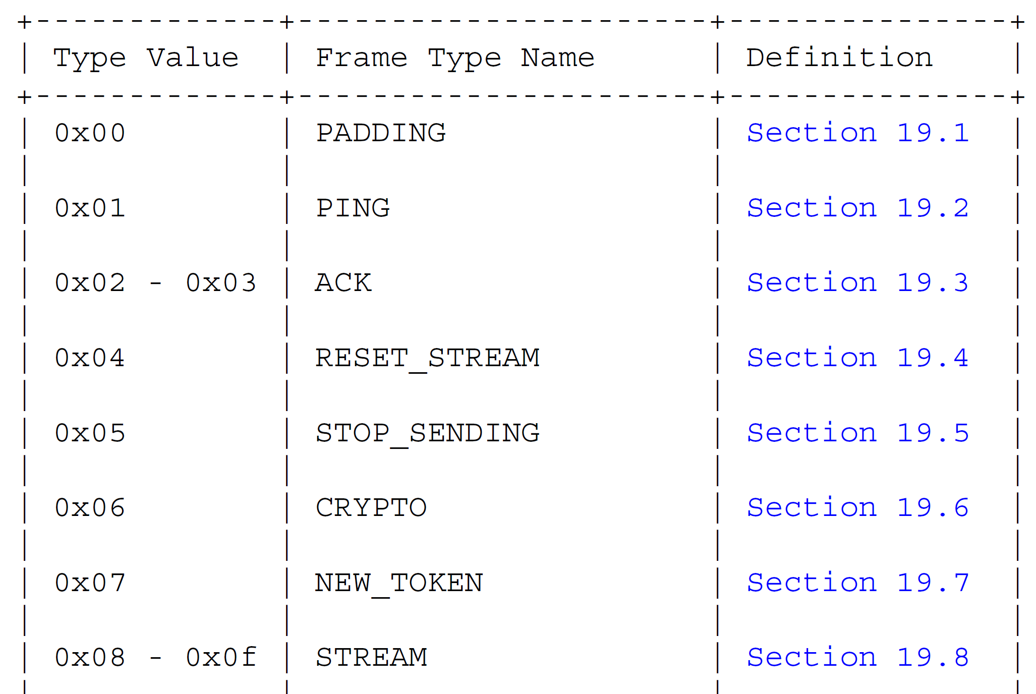
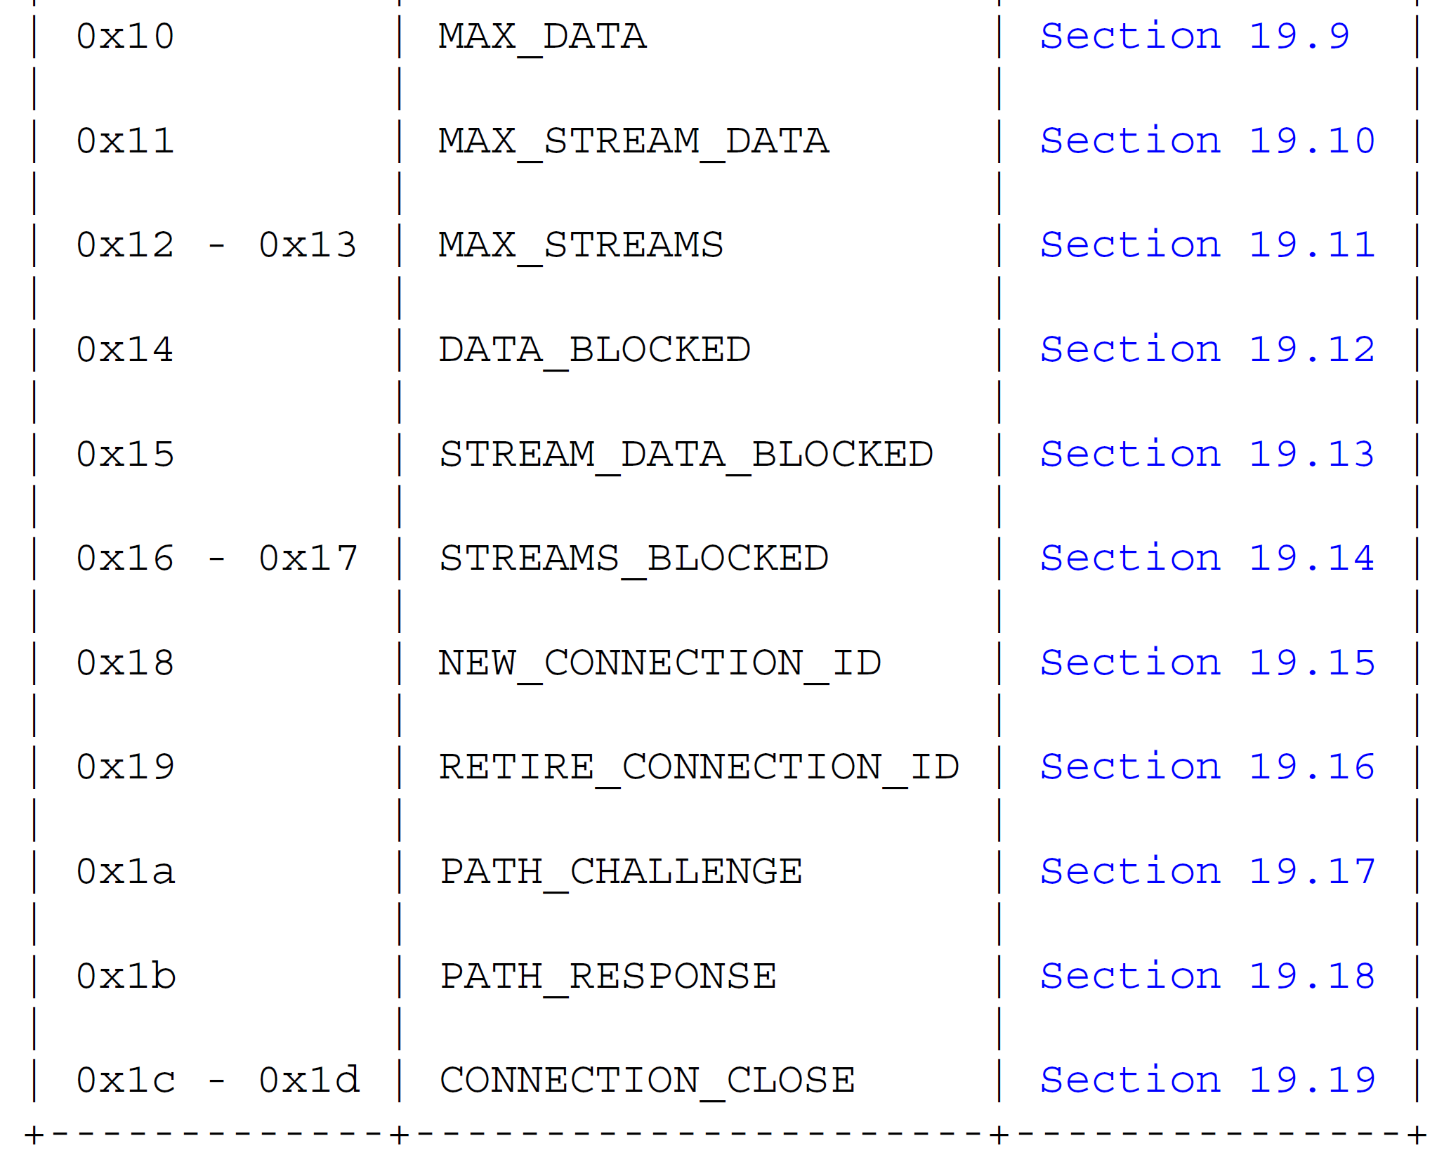
QUIC Frames

Slide 27
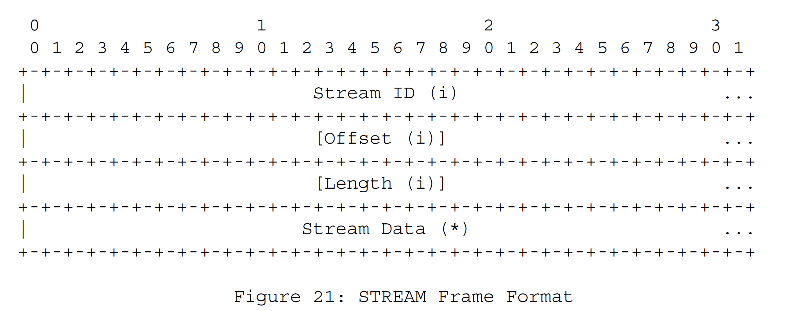
Stream Frame

Slide 28
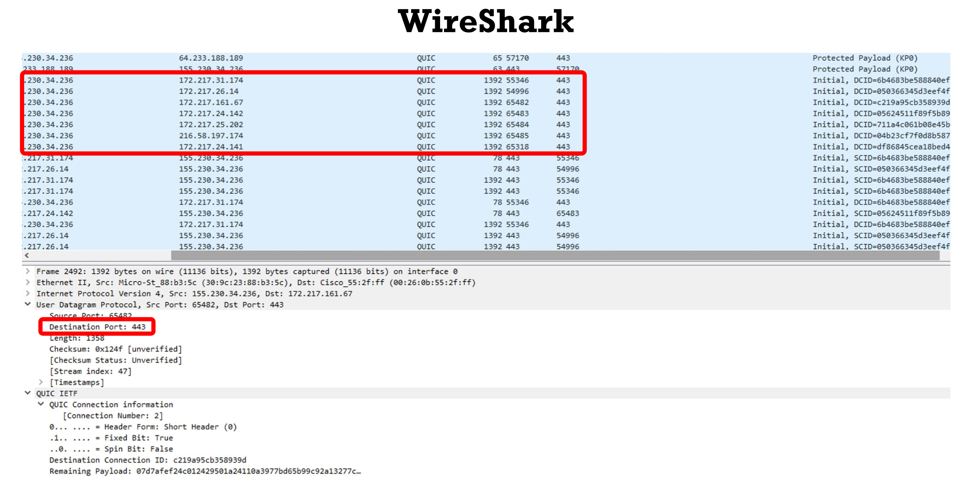

Slide 29
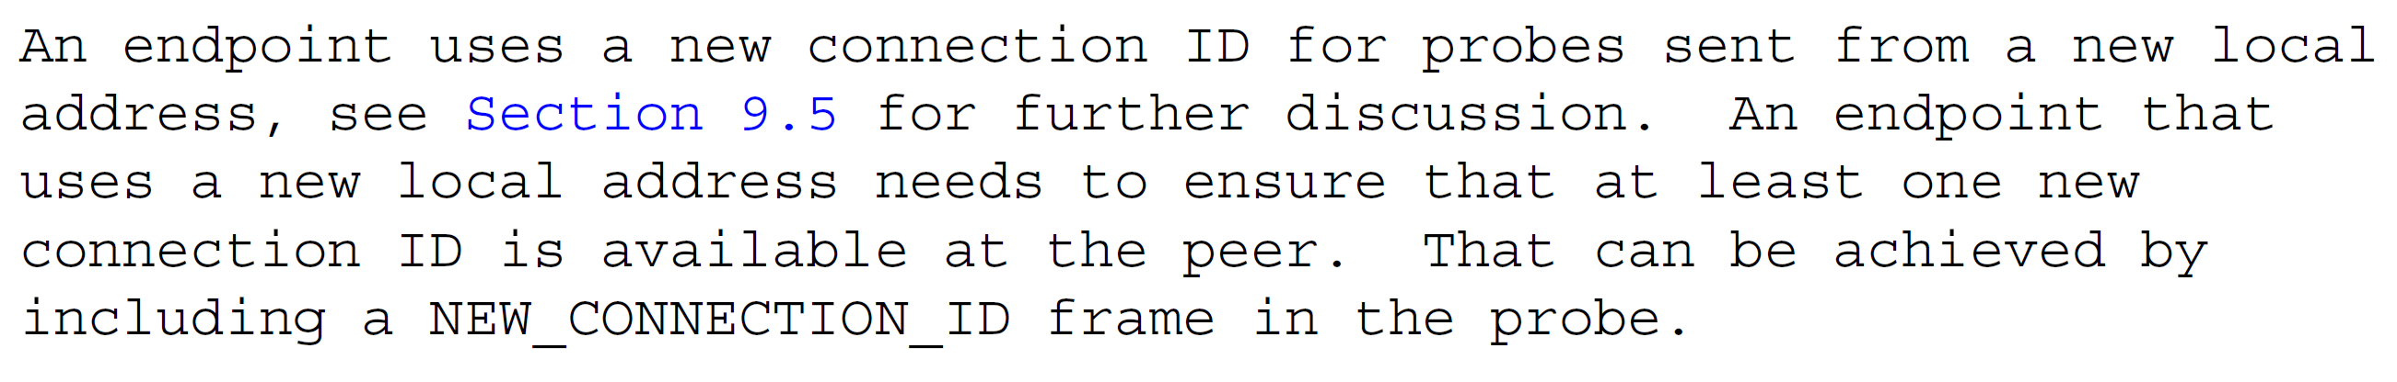
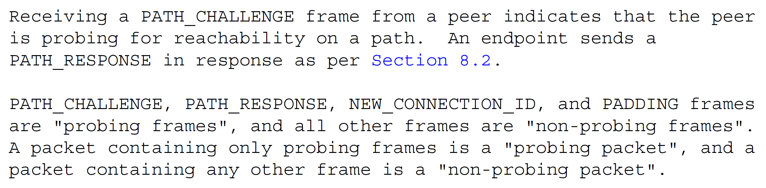
Connection Migration

Slide 30
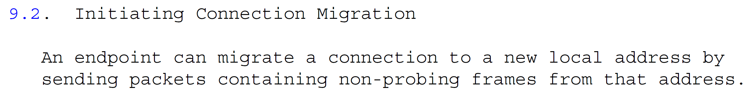
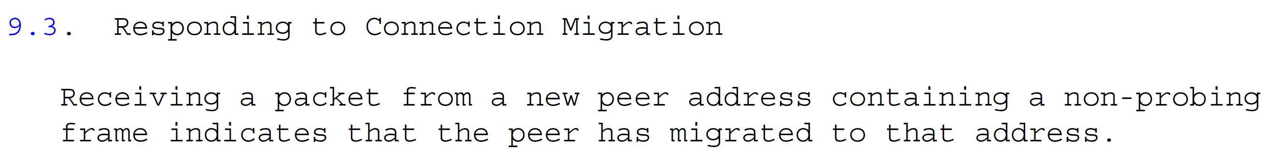
Connection Migration

Slide 31
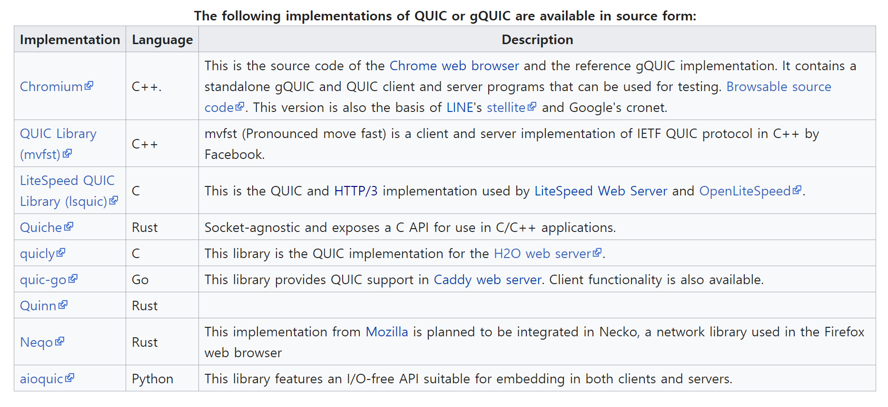
QUIC Implementations

Slide 32
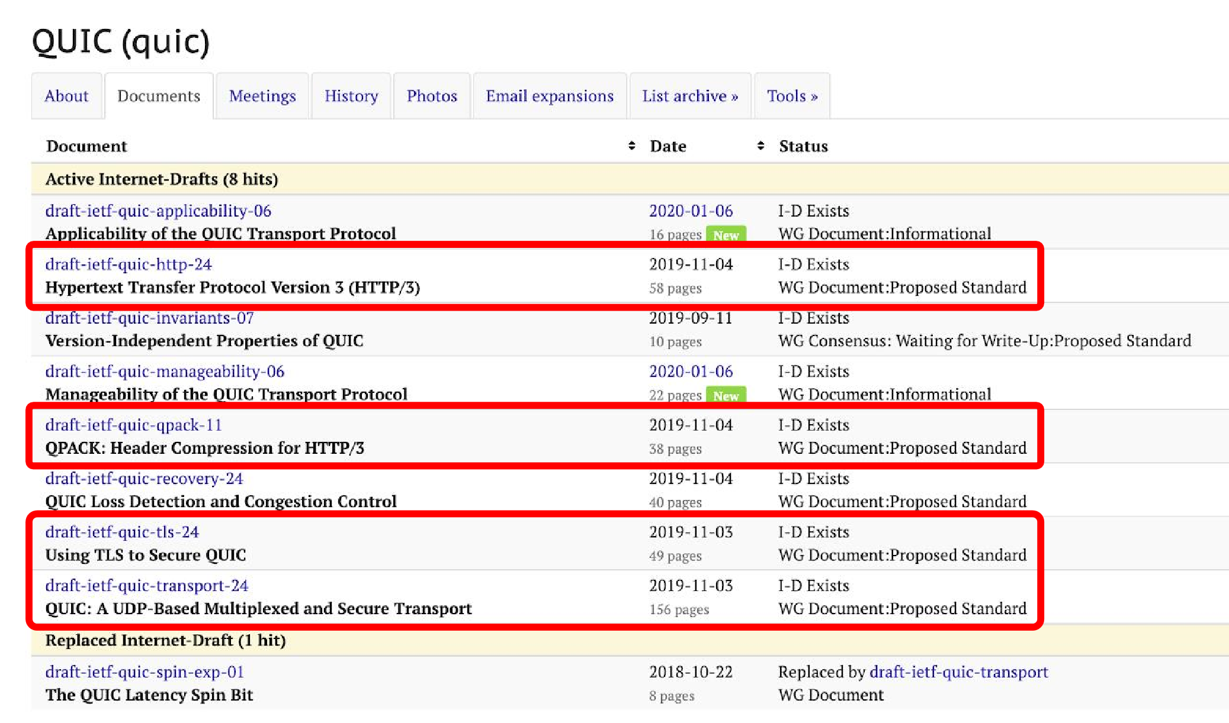
QUIC WG I-D in IETF

Slide 33
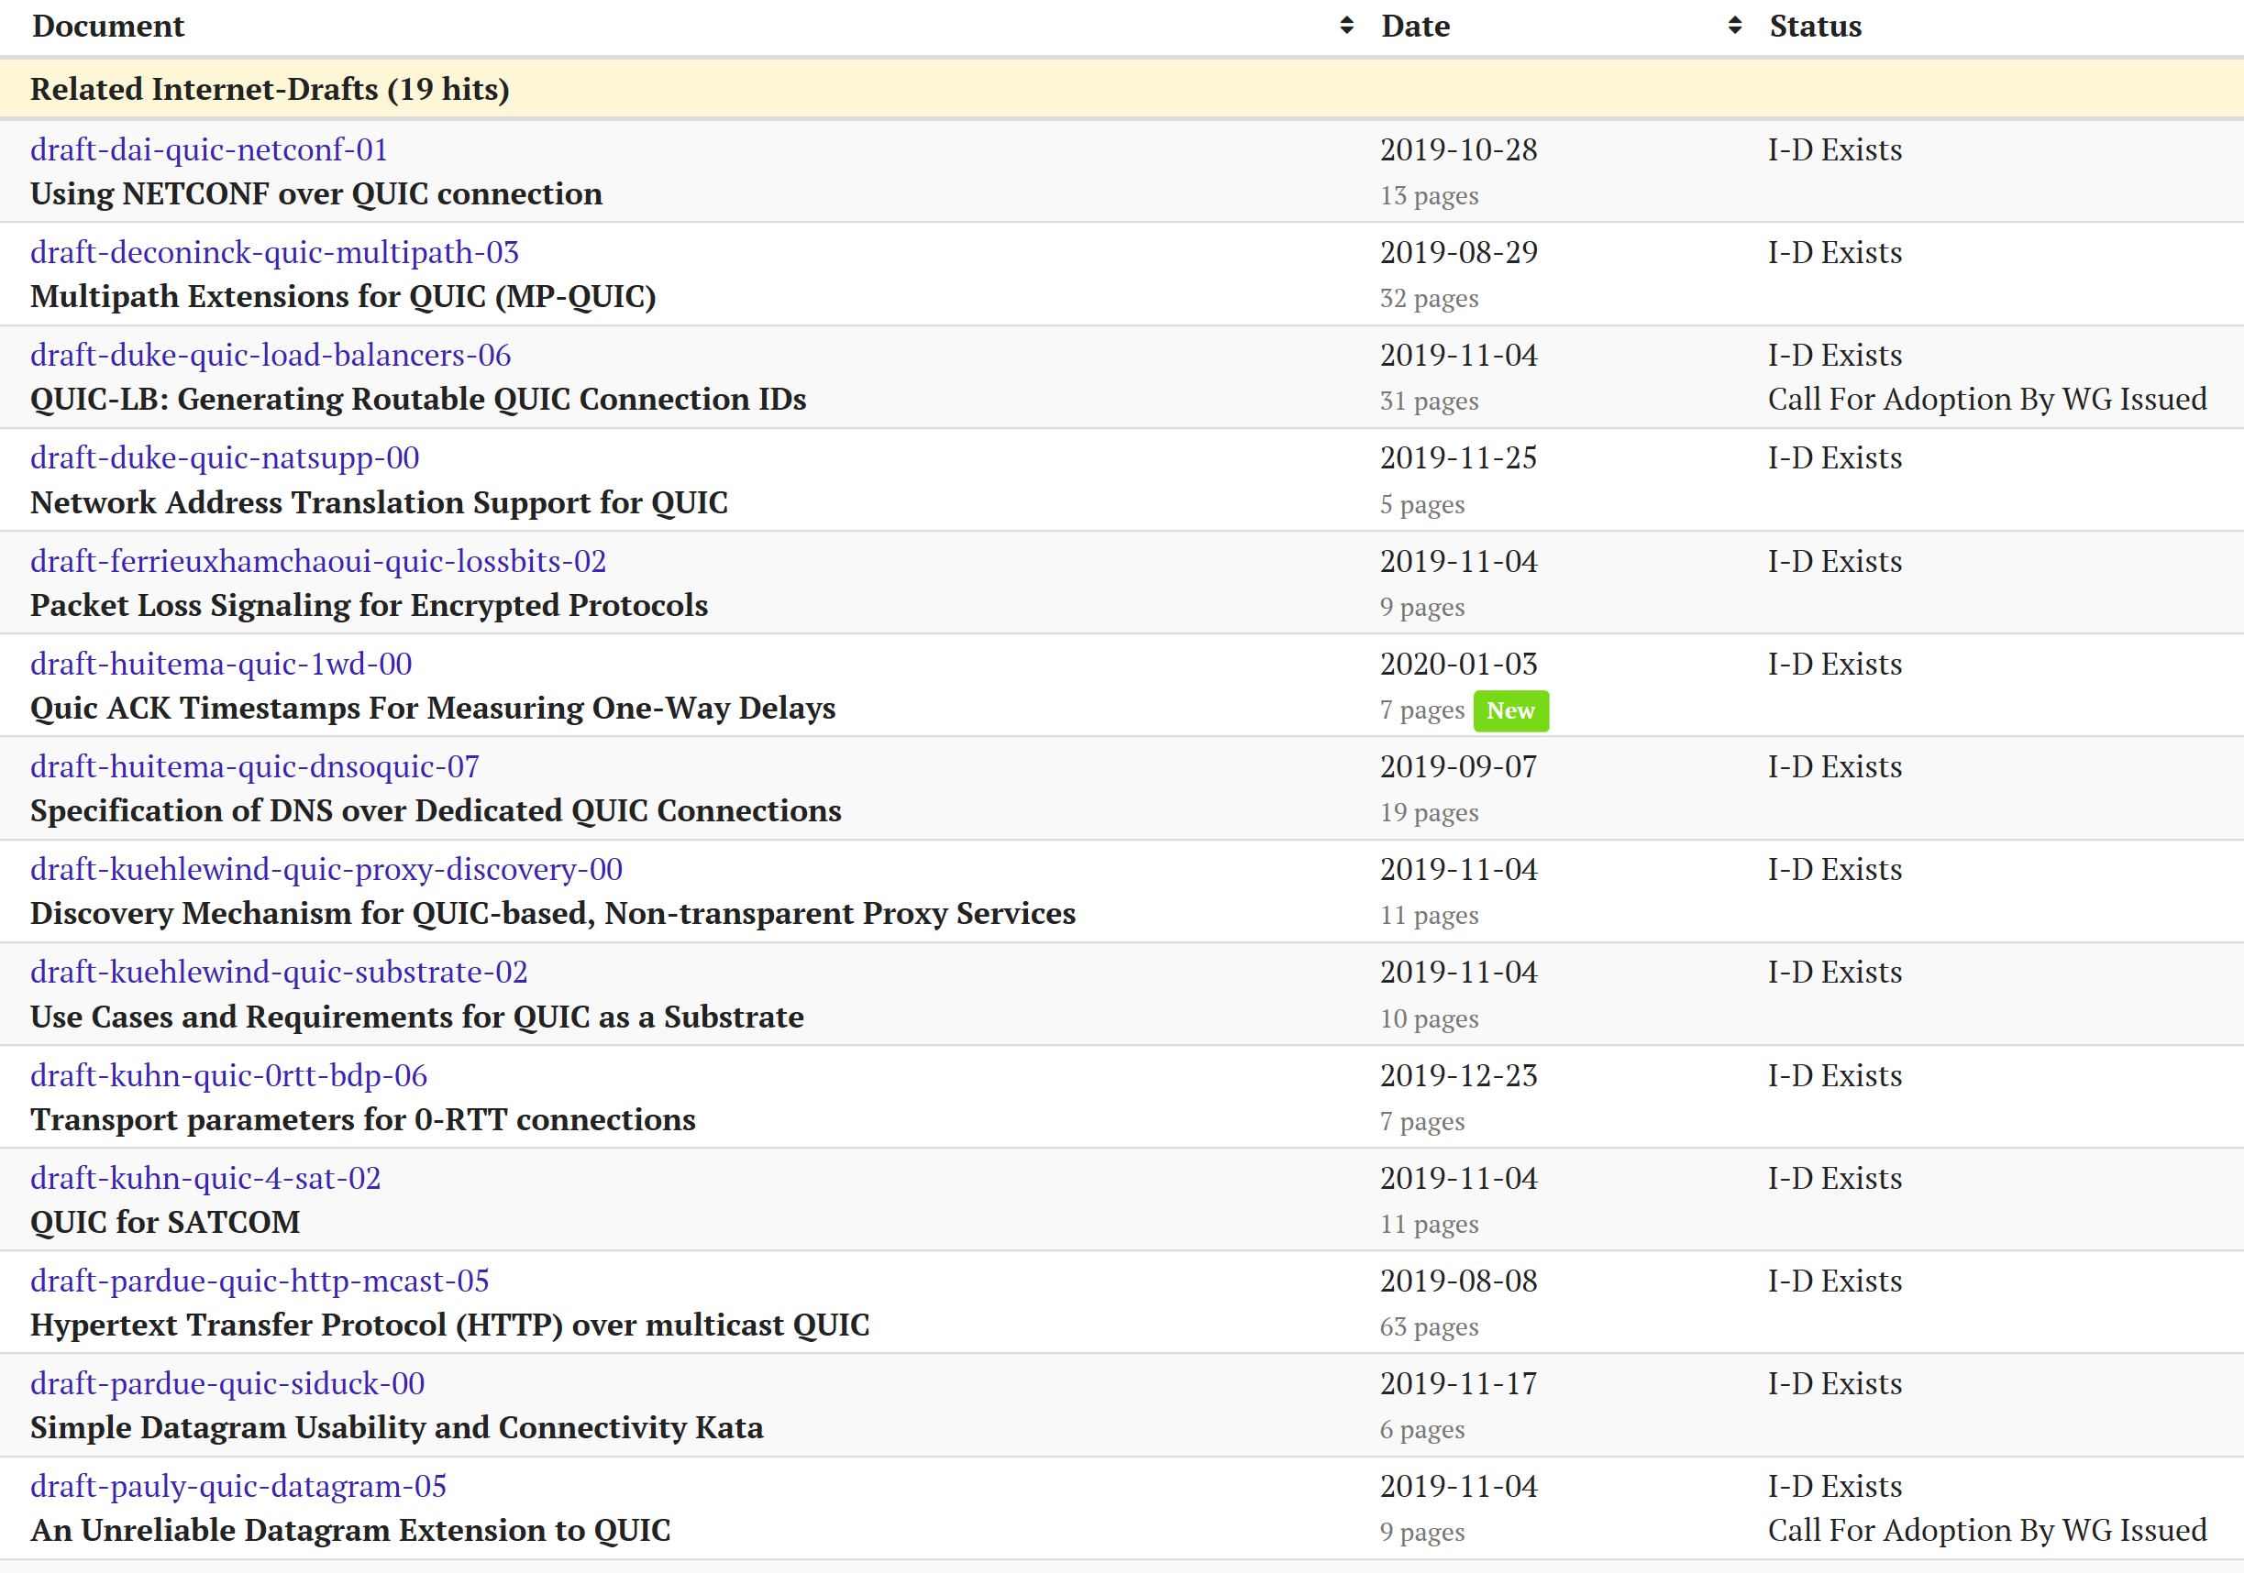
QUIC WG Individual I-D in IETF

Slide 34
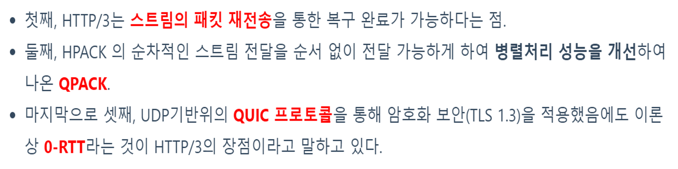
HTTP/3 (over QUIC/UDP)

Slide 35
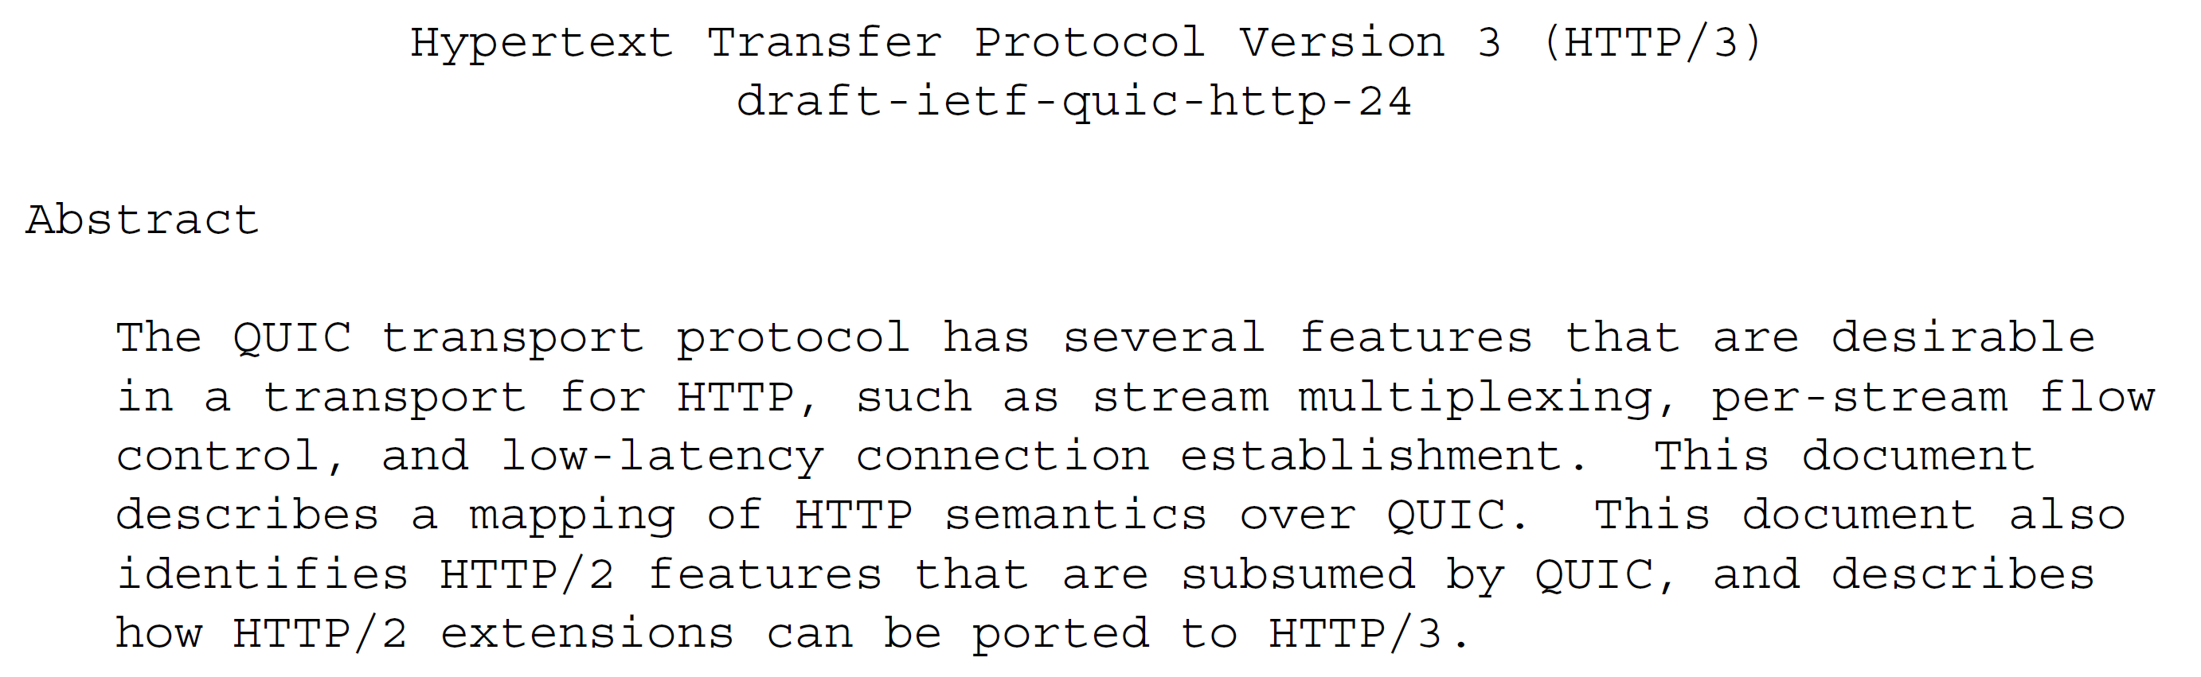
HTTP/3 (over QUIC/UDP)

Slide 36
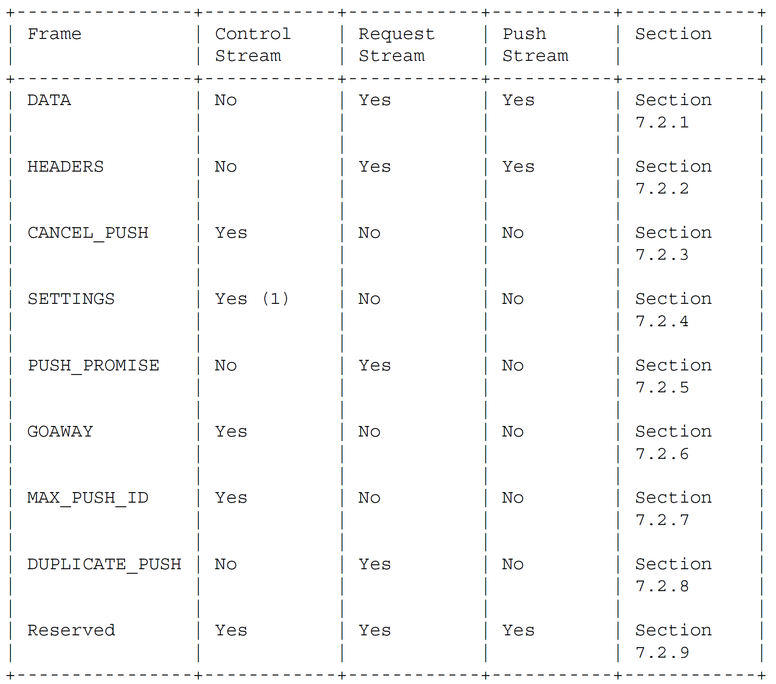
Frames in HTTP/3
HTTP/3 frames can span multiple packets, unlike QUIC frames !

Slide 37
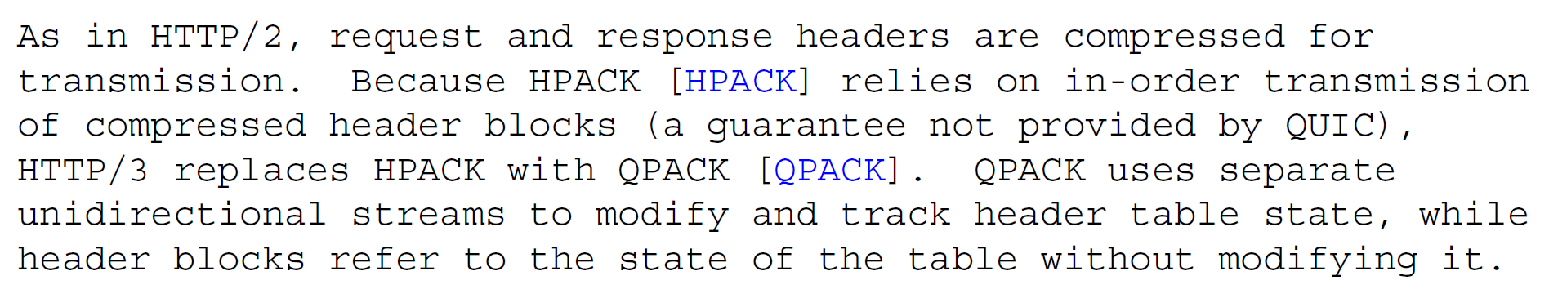
QPACK in HTTP/3

Slide 38
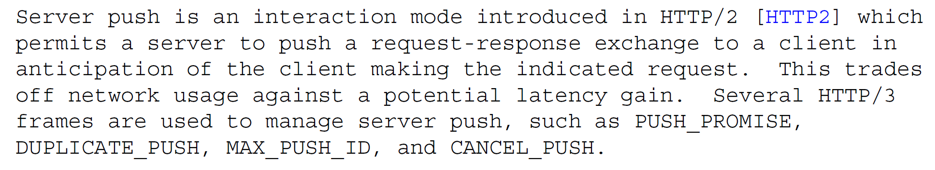
Server Push in HTTP/3

